Slide 1








Kelompok 6
Water Quality Monitoring System Using pH and Temperature Sensors (AquaNest)
Calista Aurelia - 2702208612
Stevina Dwicahya Budi - 2702240771
Shana Grace Sitompul - 2702213455

Slide 2

SDG
Proyek ini mendukung Sustainable Development Goal (SDG) 14: Life Below Water, yang bertujuan untuk melindungi dan melestarikan ekosistem perairan, termasuk laut, sungai, dan kolam buatan. Dengan menjaga kadar oksigen terlarut tetap stabil melalui sistem monitoring dan aerasi otomatis, proyek ini
membantu mencegah kematian biota air, menjaga kualitas air, serta mendukung keseimbangan ekosistem akuatik. Upaya ini sejalan dengan target SDG 14 untuk mengurangi kerusakan ekosistem air dan meningkatkan ketahanan habitat bawah air terhadap perubahan lingkungan.

Slide 3
Latar Belakang
Pemantauan kualitas air secara real-time dengan IoT terbukti meningkatkan efisiensi dan produktivitas akuakultur. Tambak udang di Indonesia mencatat peningkatan hasil hingga 30%, dan biaya operasional turun lebih dari 90% dibanding pemantauan manual.
Dikarenakan sensor oksigen sangat mahal maka, pH dan suhu dapat digunakan sebagai indikator tidak langsung untuk mengukur kadar oksigen terlarut (DO) karena keduanya sangat memengaruhi dinamika kelarutan oksigen dalam air. Semakin tinggi suhu air, semakin rendah kemampuan air untuk melarutkan oksigen, sesuai dengan prinsip kelarutan gas dalam hukum Henry. Sementara itu, pH memengaruhi keseimbangan ion-ion seperti karbonat dan bikarbonat yang berperan dalam respirasi mikroorganisme serta proses kimia yang memengaruhi konsumsi dan ketersediaan oksigen. Dengan memantau kedua parameter ini, perubahan DO dapat diprediksi secara akurat tanpa perlu sensor oksigen yang mahal dan rentan gangguan.

Slide 4

Tujuan
Mengembangkan sistem monitoring kualitas air berbasis IoT yang mampu menampilkan data pH, kadar oksigen terlarut, dan suhu secara real-time melalui aplikasi mobile.
Meningkatkan efisiensi pengelolaan kualitas air pada sektor budidaya perikanan dan industri air lainnya dengan teknologi yang mudah digunakan dan hemat biaya.
1
2
Memberikan fitur kontrol aerator jarak jauh yang memungkinkan pengguna untuk mengatur tingkat oksigen di dalam air kapan saja melalui internet.
3

Slide 5

Manfaat
1
Dapat memantau pH, estimasi kadar oksigen air, dan suhu secara real-time melalui aplikasi mobile dengan cara yang sederhana.
2
Penggunaan sensor pH dan sensor suhu sebagai indikator oksigen mengurangi biaya instalasi dan operasional dibandingkan penggunaan sensor oksigen terlarut konvensional.
3
Dapat menghidupkan atau mematikan aerator secara jarak jauh untuk menjaga kadar oksigen secara efisien dan hemat energi.

Slide 6
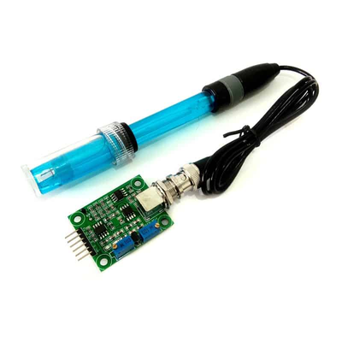
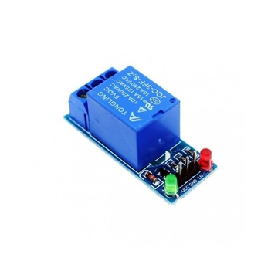
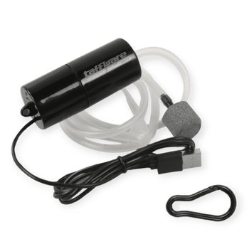
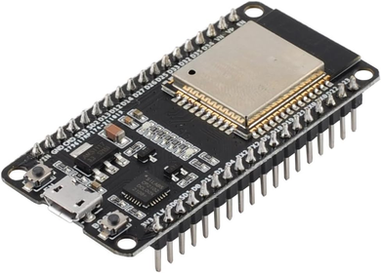

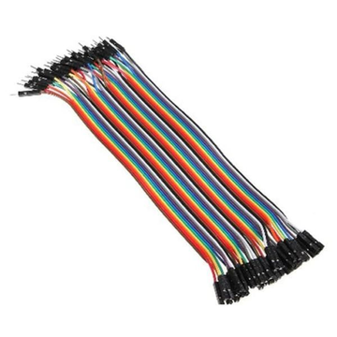
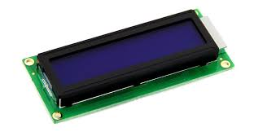

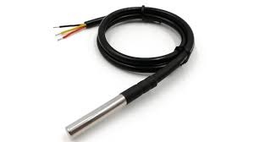
Komponen
Sensor pH
ESP 32
Relay
Aerator
Kabel
LCD
Sensor suhu
Firebase
Android Studio

Slide 7
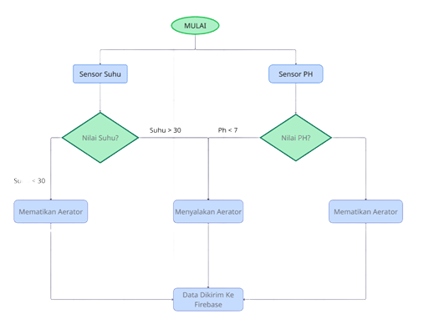
Flowchart

Slide 8
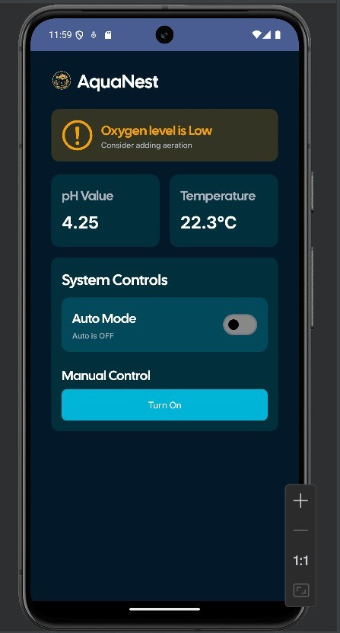
Aplikasi

Slide 9
Video
https://binusianorg-my.sharepoint.com/personal/calista_aurelia_binus_ac_id/_layouts/15/guestaccess.aspx?share=EXFXUBlweDlNoDL8TvemISMB_Ct4DDnbntbG-9O3DeSXlw&nav=eyJyZWZlcnJhbEluZm8iOnsicmVmZXJyYWxBcHAiOiJPbmVEcml2ZUZvckJ1c2luZXNzIiwicmVmZXJyYWxBcHBQbGF0Zm9ybSI6IldlYiIsInJlZmVycmFsTW9kZSI6InZpZXciLCJyZWZlcnJhbFZpZXciOiJNeUZpbGVzTGlua0NvcHkifX0&e=fegLwH
v

Slide 10
Daftar Pustaka
M. P. Sharma et al., “Water Quality Parameters: A Review,” International Journal of Engineering Research and Applications (IJERA), vol. 10, no. 6, pp. 13–17, 2020.
R. Ramya and S. Shanmugasundaram, “Smart water quality monitoring system using IoT environment,” Int. J. Pure Appl. Math., vol. 119, no. 16, pp. 2219–2225, 2018.
Hariyadi, M. Kamil, and P. Ananda, “Sistem pengecekan pH air otomatis menggunakan sensor pH probe berbasis Arduino pada sumur bor,” RANG TEKNIK Journal. Available: https://jurnal.umsb.ac.id/index.php/RANGTEKNIKJOURNAL/article/view/1930/1609
D. W. Otterson, “pH Measurement and Control Basics,’ SAGE journals. Available: https://pmc.ncbi.nlm.nih.gov/articles/PMC4180894/
W. Aoi, Y. Marunaka, “Importance of pH Homeostasis in Metabolic Health and Diseases: Crucial Role of Membrane Proton Transport,” BioMed Research International. Available: https://pmc.ncbi.nlm.nih.gov/articles/PMC4180894/
H. Dallas, “The effect of Water Temperature on Aquatic Organisms: A Review of Knowledge and Methods for Assessing Biotic Response to Temperature,” Water Research Commision. Available: https://www.researchgate.net/publication/268803537_The_effect_of_water_temperature_on_aquatic_organisms_A_review_of_knowledge_and_methods_for_assessing_biotic_responses_to_temperature
[B. Ali, Anushka, A. Mishra, “Effects of Dissolved Oxygen Concentration on Freshwater Fish,” International Journal of Fisheries and Aquatic Studies. Available: https://www.researchgate.net/publication/362634321_Effects_of_dissolved_oxygen_concentration_on_freshwater_fish_A_review
R. V. Sunyer, C. M. Duarte, “Thresholds of Hypoxia for Marine Biodiversity,” PubMed. Available: https://www.researchgate.net/publication/23289890_Thresholds_of_hypoxia_for_marine_biodiversity?utm_source=chatgpt.com
R. Nordio, E. Viviano, A. S. Zurano, “Influence of pH and Dissolved Oxygen Control Strategies on The Performance of Pilot-scale Microalgae Raceways Using Fertilizer or Wastewater as the Nutrient Source,” Journal of Environmental Management. Available: https://www.sciencedirect.com/science/article/abs/pii/S0301479723016870
S. Zainab, N. Handajani, H. Wibisana, “Acidity (pH) and Dissolved Oxygen Levels as Indicators of Water Quality Around the Tuban Coastal Area,” NST Proceedings. Available: https://nstproceeding.com/index.php/nuscientech/article/download/768/727/2365
L. Zeng, C. Yan, F. Yang, Z. Zhen, J. Yang, “The Effects and Mechanisms of pH and Dissolved Oxygen Conditions on the Release of Arsenic at the Sediment-Water Interface in Taihu Lake,” MDPI. Available: https://www.mdpi.com/2305-6304/11/11/890
F. Febiyanto, “Effects of Temperature and Aeration on The Dissolved Oxygen (DO) Values in Freshwater Using Simple Water Bath Reactor,” Walisongo Journal of Chemistry. Available: https://www.researchgate.net/publication/343665631_Effects_of_Temperature_and_Aeration_on_The_Dissolved_Oxygen_DO_Values_in_Freshwater_Using_Simple_Water_Bath_Reactor_A_Brief_Report
E. W. Pratama, A. Kriswantono, “Electrical Analysis Using ESP-32 Module in Realtime,” Journal of Electrical Engineering and Computer Sciences. Available: https://ejournal.ubhara.ac.id/jeecs/article/download/21/11
Ozami. “Mengenal ESP32, Mikrokontroler IoT”. Availabale: https://ozami.co.id/mengenal-esp32-mikrokontroler-iot/
DigiwareStore. “Gravity: Analog pH Sensor / Meter Kit for Arduino Ver.1”. Available: https://digiwarestore.com/id/sensor-other/gravity-analog-ph-sensor-meter-kit-for-arduino-ver1-296334.html
Y. Tjandi, S. Kasim, “Electric Control Equipment Based on Arduino Relay,” Journal of Physics Conference Series. Available: https://www.researchgate.net/publication/334023870_Electric_Control_Equipment_Based_on_Arduino_Relay
SunFounder. “5V Relay Module”. Available: https://docs.sunfounder.com/projects/ultimate-sensor-kit/en/latest/components_basic/25-component_relay.html
V. P. S. Bentulan, “Temperature Sensor Using Arduino,” Research Gate. Available: https://www.researchgate.net/publication/361320414_Temperature_Sensor_Using_Arduino
Random Nerd Tutorials. “9 Arduino Compatible Temperature Sensors for Your Electronics Projects”. Available: https://randomnerdtutorials.com/9-arduino-compatible-temperature-sensors-for-your-electronics-projects/
M. A. D. Perin, M. J. Cuaton, A. J. Rapirap, “Automated Aerator System for Controlling Dissolved Oxygen and Monitoring Acidity and Temperature on Aquatic System,” Research Gate. Available: https://www.researchgate.net/publication/326129037_AUTOMATED_AERATOR_SYSTEM_FOR_CONTROLLING_DISSOLVED_OXYGEN_AND_MONITORING_ACIDITY_AND_TEMPERATURE_ON_AQUATIC_SYSTEM
“Aerator Portable USB Taffware Fish Tank Aquarium”. Available: https://shopee.co.id/Aerator-Portable-USB-Taffware-Fish-Tank-Aquarium-i.48977535.24300326771
HowToMechatronics. “Arduino 16×2 LCD Tutorial – Everything You Need to Know”. Available: https://howtomechatronics.com/tutorials/arduino/lcd-tutorial/#google_vignette
S. I. Patty, M. P. Rizqi, dan R. Huwae, “Oksigen Terlarut di Perairan Bolaang Mongondow Timur, Sulawesi Utara (Dissolved Oxygen in the East Bolaang Mongondow Waters, North Sulawesi),” Jurnal Ilmiah Platax, vol. 10, no. 1, pp. 216, Jan.–Jun. 2022. Available: https://ejournal.unsrat.ac.id/v3/index.php/platax/article/view/40434/36679

Slide 11
Terima Kasih

